Slide 1
Are Nonfat Starbucks Drinks actually Healthy or just a Deception?
Chris Coble
7/2024
For Non-Technical Stakeholders

Slide 2

A Rude Awakening: Caffeinated Beverages and Calories
Around 1 billion people drink coffee, an addictive neurostimulant, everyday
Starbucks sells 4 million cups a day across the globe
Starbucks’ popularity is attributable to their delicious sweet tasting beverages, which come at a cost: calories
1 billion people source: https://balancecoffee.co.uk/blogs/blog/global-coffee-consumption-statistics#:~:text=What%20Percentage%20Of%20People%20Drink,people)%20love%20drinking%20coffee%20daily.
4 Million Cups a day source:
https://www.reference.com/science-technology/many-cups-coffee-starbucks-sell-day-30165505f1ced767

Slide 3
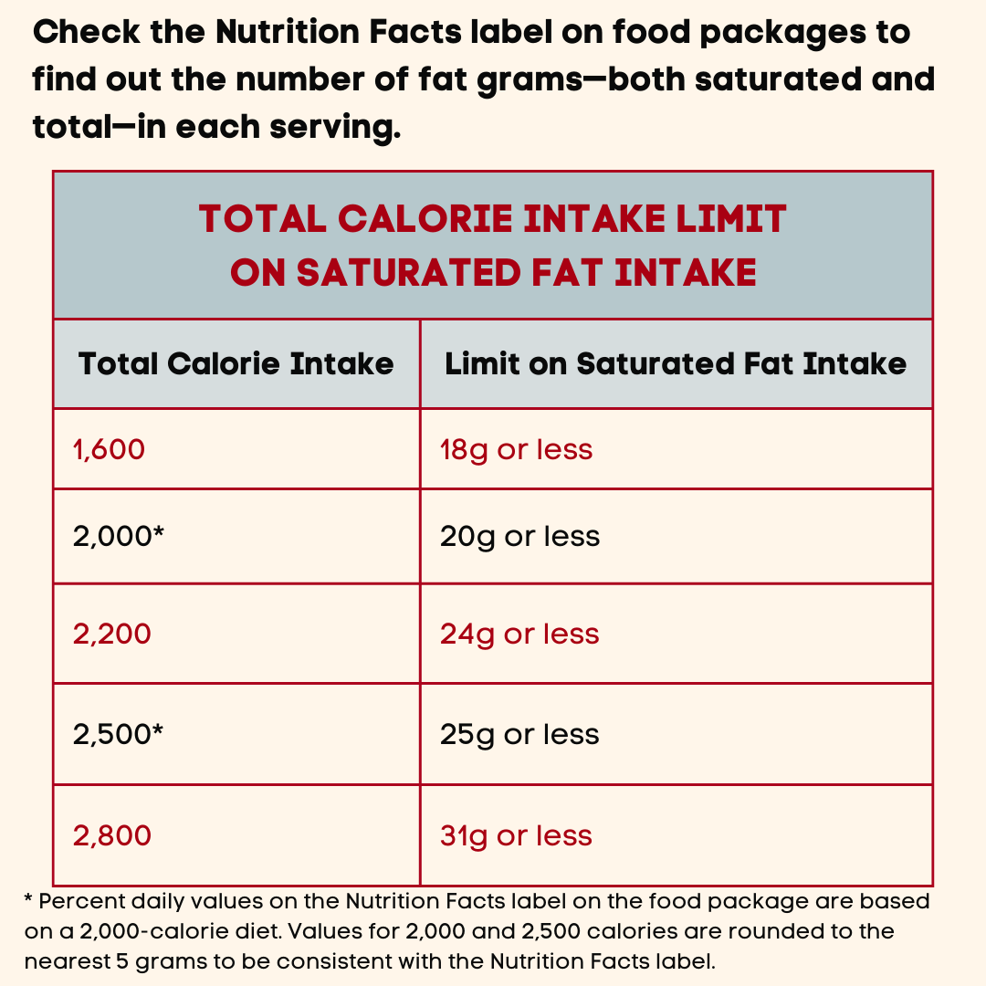
Marketing Strategy: Nonfat
Starbucks offers nonfat milk alternatives to make their beverages healthy, while keeping the flavor.
Are nonfat drinks actually calorically that different than regular drinks?
Source: https://alpinecardiology.com/a-guide-to-a-healthy-heart/figuring-out-fat/

Slide 4
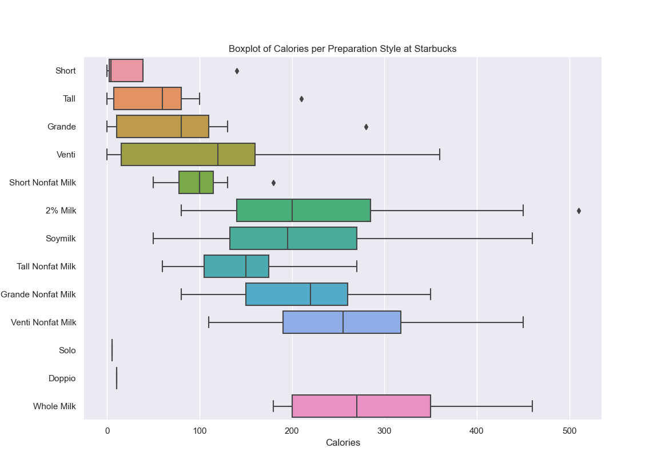
Starbucks calories per Size and Preparation Styles
No Additive Sizes
Nonfat Milk Sizes
Starbucks beverages with Nonfat Milk have higher median calories than their no additive partners.
2% Milk, Soymilk, and Whole Milk (fat milk) seem to be either slightly higher or on par with Nonfat Milk.
Source: https://www.kaggle.com/datasets/starbucks/starbucks-menu?resource=download

Slide 5
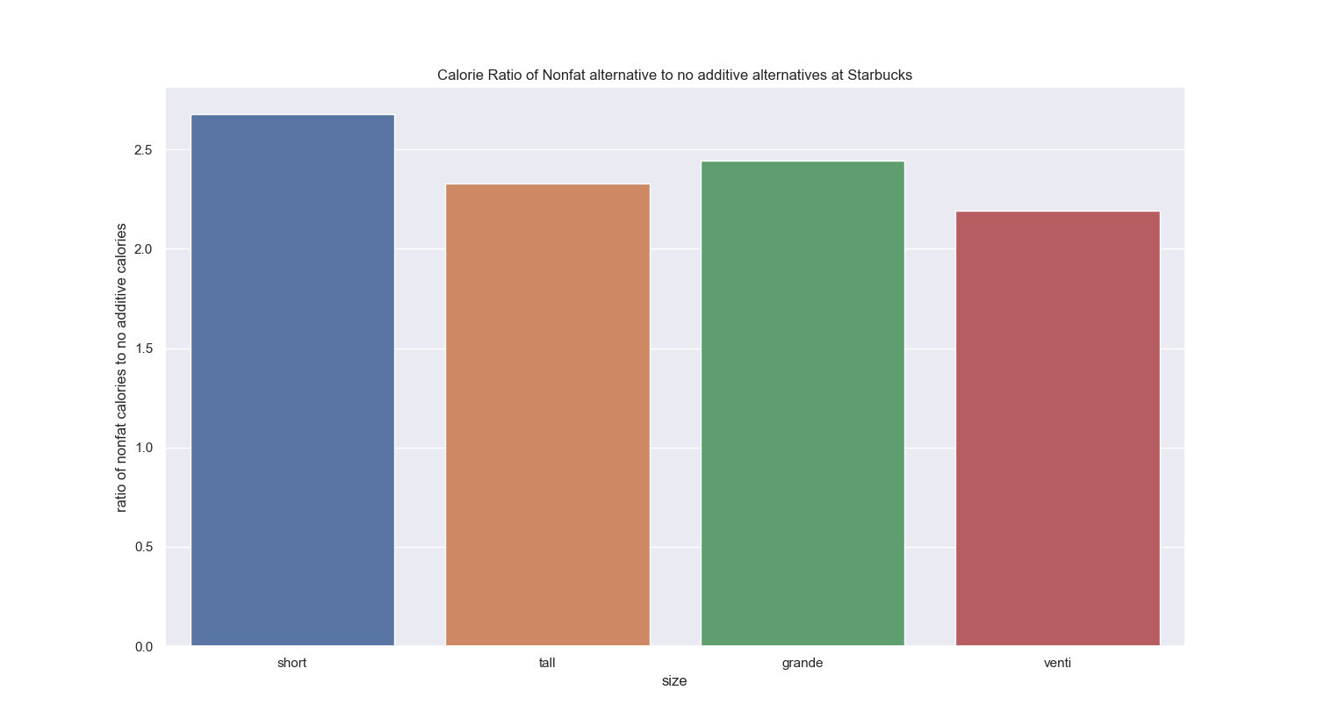
Nonfat Milk Additives vs. Regular Coffee Calories per Serving Size
Even being “Nonfat milk”, these drinks still are around 2.25 times higher in calories than regular coffee.
Source: https://www.kaggle.com/datasets/starbucks/starbucks-menu?resource=download

Slide 6
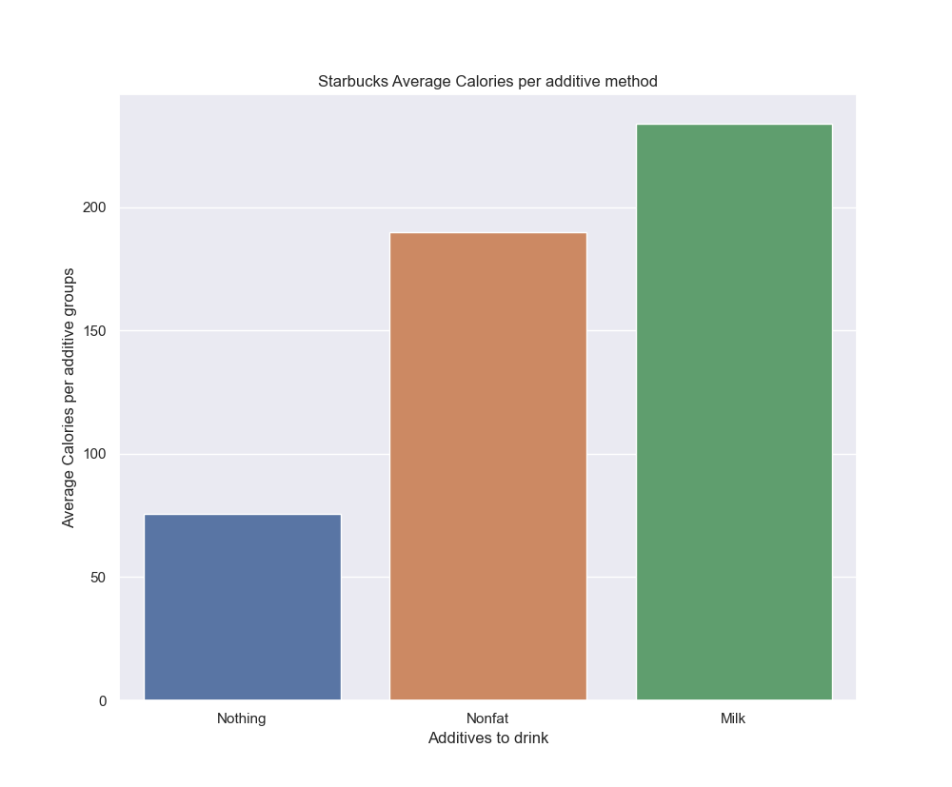
No additives vs. Nonfat Milk vs. Fat Milk Average Calories
Nonfat milk drinks are on average 80% the caloric value of regular milk drinks.
This 80% corresponds to approximately 200 calories.
Source: https://www.kaggle.com/datasets/starbucks/starbucks-menu?resource=download

Slide 7
Nonfat Milk Drinks have Significant Calories despite Healthy Advertising
Despite the nonfat caloric average being a decrease from regular milk, the drink still contains around 200 calories, 10% of the daily intake recommendation
Do you really want your coffee to be 10% of your recommended daily food intake?

